Slide 1
Virtualization and containerization. Hypervisors

Slide 2
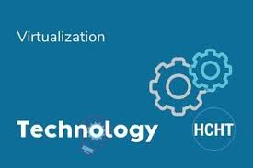
What is virtualization?
Virtualization is a technology that lets you create useful IT services using resources that are traditionally bound to hardware. The technologies that enabled virtualization—like hypervisors—were developed decades ago to give multiple users simultaneous access to computers that performed batch processing. Batch processing was a popular computing style in the business sector that ran routine tasks thousands of times very quickly. Virtualization’s widespread applicability helped reduce vendor lock-in and made it the foundation of cloud computing.

Slide 3
How does it work?
Software called hypervisors separates the physical resources from the virtual environments—the things that need those resources. Hypervisors can sit on top of an operating system (like on a laptop) or be installed directly onto hardware (like a server), which is how most enterprises virtualize. Hypervisors take your physical resources and divide them up so that virtual environments can use them.

Slide 4
Types of virtualization
Data virtualization:
Data virtualization tools sit in front of multiple data sources and allows them to be treated as a single source, delivering the needed data—in the required form—at the right time to any application or user.
Desktop virtualization
desktop virtualization allows admins to perform mass configurations, updates, and security checks on all virtual desktops.
Server virtualization
Servers are computers designed to process a high volume of specific tasks really well so other computers—like laptops and desktops—can do a variety of other tasks.
Operating system virtualization
Operating system virtualization happens at the kernel—the central task managers of operating systems. It’s a useful way to run Linux and Windows environments side-by-side.

Slide 5
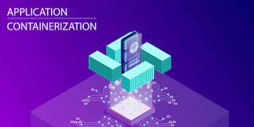
containerization
Containerization is the packaging together of software code with all it’s necessary components like libraries, frameworks, and other dependencies so that they are isolated in their own "container“. Containers are an alternative to coding on one platform or operating system. Similarly, developers can use the same tools when working with containers in one host environment as they’d use in another, which makes the development containerized apps across operating systems much more simple.

Slide 6
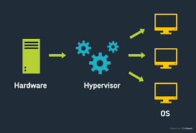
Hypervisors
A hypervisor, also known as a virtual machine monitor or VMM, is software that creates and runs virtual machines (VMs). A hypervisor allows one host computer to support multiple guest VMs by virtually sharing its resources, such as memory and processing. Hypervisors make it possible to use more of a system’s available resources and provide greater IT mobility since the guest VMs are independent of the host hardware. This means they can be easily moved between different servers. There are two main hypervisor types, referred to as “Type 1” (or “bare metal”) and “Type 2” (or “hosted”). A type 1 hypervisor acts like a lightweight operating system and runs directly on the host’s hardware, while a type 2 hypervisor runs as a software layer on an operating system, like other computer programs.

